Slide 1

GUDIE K. Mohan Krishna, M.tech., ASSISTANT PROFESSOR Department of ECE
Vehicle theft intimation over SMS and remote control of its engine
SHREE INSTITUTE OF TECHNICAL EDUCATION
(APPROVED AICTE NEW DELHI,AN ISO 9001:2008 CERTIFIED INSTITUTION ,AFFILIATED TO JNTU,ANANTAPUR)
Deparment of Electronics And Communication Engineering
TEAM MEMBERS
P. Thanishka 194A1A0413
R. Rekha 194A1A0407
K. Ravichandra 194A1A0402
S. Sravani 194A1A0416
S. Sailakar 194A1A0408

Slide 2
CONTENTS
Abstract
Objective
Introduction
Existing system
Proposed system
Requirements
Block diagram
Description of parts
Applications
Advantages
Future scope
Conclusion
Reference

Slide 3
ABSTRACT
Now-a-days number of vehicles can be seen on roads. Most of the people prefer to buy a vehicle for themselves or their family.
As the vehicle theft rate is going up, security system for vehicles is extremely essential.
In this proposed system if someone tries to steal the vehicle, the microcontroller gets an interrupt through a switch mechanism and commands the GSM modem to send an SMS.
The owner receives the SMS that his vehicle is being stolen. Owner can send back an SMS to the GSM modem to "stop the engine".
Microcontroller receives the message, the output activates the mechanism that disables the ignition of the vehicle and it will be stopped.

Slide 4
OBJECTIVE
The aim of this project is to use wireless technology to intimate the owner of the vehicle about an un-authorized entry.
This is done by sending an auto-generated SMS to the owner.
An added advantage of this project is that the owner can send back the SMS which will disable the ignition of the vehicle.

Slide 5
INTRODUCTION
With the rapid development of national economy, automobiles have increased greatly as they are playing a crucial role in human’s life.
However, in this modern technology crimes are being smarter and the automobiles are being stolen frequently.
Electronics with anti-theft technology is widely used now a days.
GSM (global system for mobile communication) is a case which is the most mature and widely used in mobile communication system.
It ensures the information transmission so real-time, security and reliable that realizes the long distance control.
This paper is about a design of a new fashion auto-guard which is a smart measurement generalized in the automobile security area.

Slide 6
EXSITING SYSTEM
In the existing system, vehicles are tracked by persons manually.
In this system we cannot monitor the location of the vehicle remotely.
We cannot find the status of the vehicle.

Slide 7
PROPOSED SYSTEM
In this project we are using Vibration sensor to detect the theft happening.
Initially if we want to start the bike we need to switch ON the ignition key at that time, if the sensor detects vibration, it means not theft.
Otherwise, if the sensor detects when the ignition key is in OFF condition then a message will be sent to the owner. The motor will be in Stop condition only.

Slide 8
REQUIREMENTS:
Hardware requirements:
Arduino
Power supply
Vibration sensor
GPS
GSM
LCD
Relay
DC motor
Software requirements :
Arduino IDE

Slide 9
BLOCK DIAGRAM:
Power Supply
Arduino
Vibration Sensor
LCD
Ignition Key
GSM
Relay
DC Motor
GPS

Slide 10
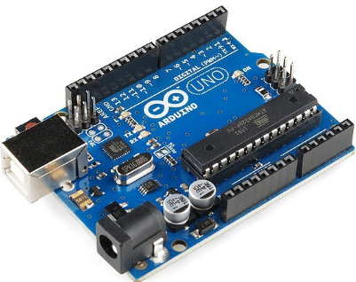
DESCRIPTION OF PARTS
ARDUINO UNO:
Arduino Uno is a microcontroller board developed by “Arduino.cc” which is an open-source electronics platform mainly based on AVR microcontroller Atmega328.
“Uno” means one in Italian and is the name to mark the upcoming release of Arduino 1.0. The Uno and version 1.0 will be the reference versions of Arduino moving forward.
The current version of Arduino Uno comes with USB interface, 6 analog input pins, 14 I/O digital ports that are used to connect with external electronic circuits. Out of 14 I/O ports, 6 pins can be used for PWM output.

Slide 11
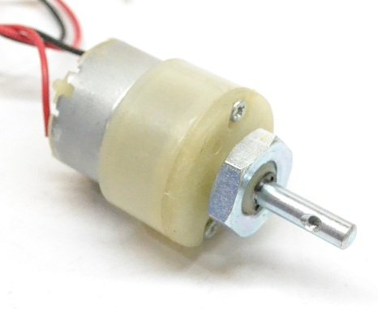
DC MOTOR:
A machine that converts D.C power into mechanical power is known as a d.c. motor.
Its operation is based on the principle that when a current carrying conductor is placed in a magnetic field, the conductor experiences a mechanical force. The direction of this force is given by “Fleming’s left hand rule” and magnitude is given by;
F = BIl newton’s
Basically, there is no constructional difference between a D.C. motor and a D.C. generator. The same D.C. Machine can be run as a generator or motor.

Slide 12
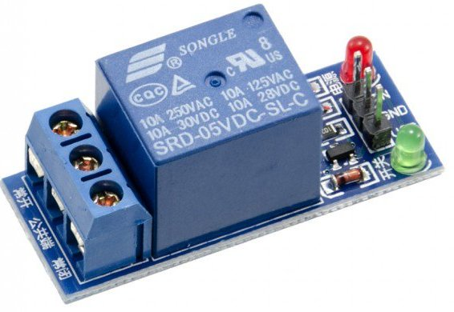
RELAY:
A relay is an electromagnetic switch that is used to turn on and turn off a circuit by a low power signal, or where several circuits must be controlled by one signal.
The switching mechanism is carried out with the help of electromagnet.
The main operation of a relay comes in places where only a low-power signal can be used to control a circuit.
The application of relays started during the invention of telephones.

Slide 13
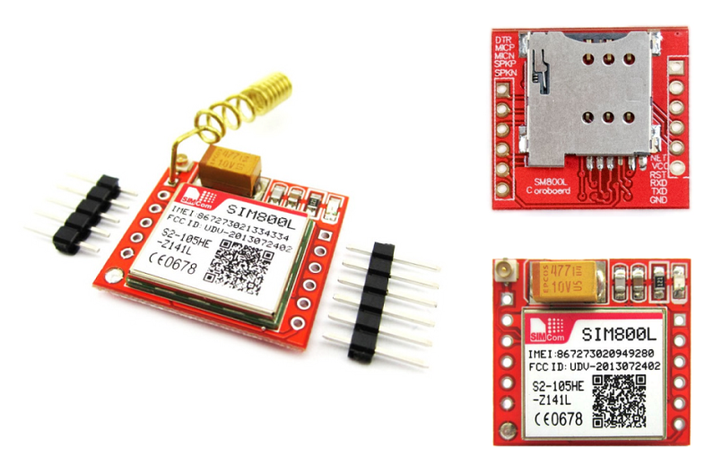
GSM(Global System for Mobile Communication):
GSM is a mobile communication modem; it is stands for global system for mobile communication (GSM). The idea of GSM was developed at Bell Laboratories in 1970.
It can be used to make a computer or any other processor communicate over a network.
A GSM modem requires a SIM card to be operated and operates over a network range subscribed by the network operator.
There are various cell sizes in a GSM system such as macro, micro, pico and umbrella . The coverage area of each cell varies according to the implementation environment.

Slide 14
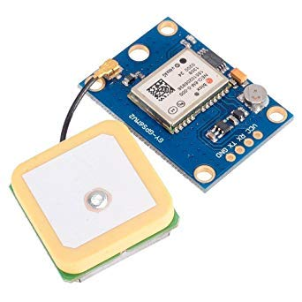
GPS(Global Positioning System):
Global Positioning System (GPS) is a satellite-based system that uses satellites and ground stations to measure and compute its position on Earth.
GPS is also known as Navigation System with Time and Ranging (NAVSTAR) GPS.
GPS receiver needs to receive data from at least 4 satellites for accuracy purpose.
This GPS receiver is used in many applications like smartphones, Cabs, Fleet management etc.

Slide 15
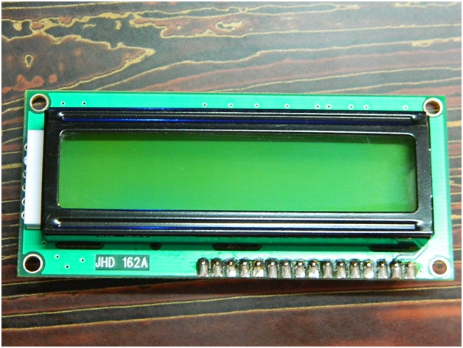
LCD(Liquid Crystal Display):
LCD (Liquid Crystal Display) is the innovation utilized in scratch pad shows and other littler PCs.
Like innovation for light-producing diode (LED) and gas-plasma, LCDs permit presentations to be a lot more slender than innovation for cathode beam tube (CRT).
LCDs expend considerably less power than LED shows and gas shows since they work as opposed to emanating it on the guideline of blocking light.

Slide 16
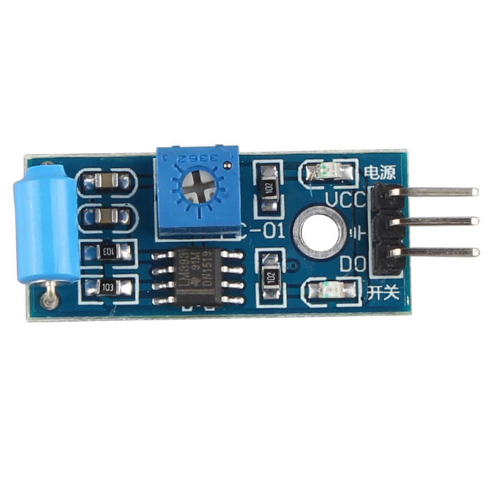
VIBRATION SENSOR:
Vibration sensors, also known as piezoelectric sensors.
These are versatile tools for the measurement of various processes.
These sensors use the piezoelectric effect, which measure changes in pressure, acceleration, temperature, strain or force by converting them to an electrical charge.
A vibration sensor can also be used to determine aromas in the air by simultaneously measuring resonance and capacitance.
The working principle of vibration sensor is a sensor which operates based on different optical otherwise mechanical principles for detecting observed system vibrations.

Slide 17
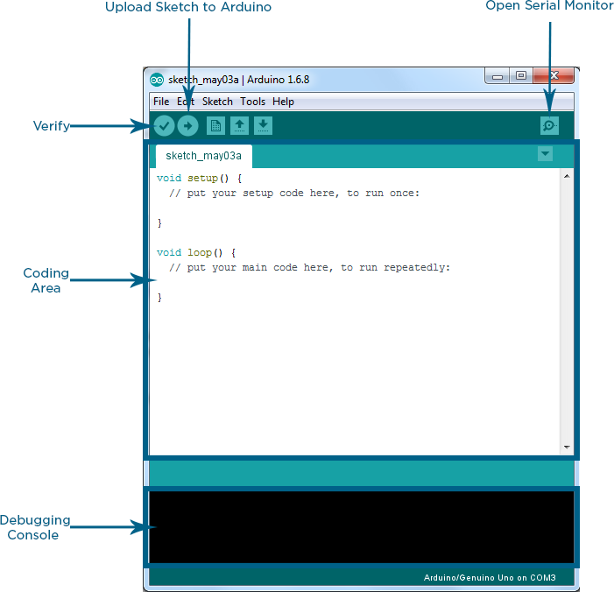
ARDUINO IDE:
Arduino IDE, where IDE stands for Integrated Development Environment.
An official software (open source software) introduced by Arduino.cc, i.e., mainly used for writing, compiling and uploading the code in the Arduino Device.
It is easily available for operating systems like MAC, Windows, and Linux and runs on the Java Platform that comes with inbuilt functions and commands that play a vital role for debugging, editing and compiling the code in the environment.

Slide 18
APPLICATIONS:
Useful to protect vehicles in parking at public places.
Useful in locating the location of vehicle in case theft happens.
Useful in monitoring the movements of vehicle when its parked.
Useful in knowing the unauthorized access of vehicle.

Slide 19
ADVANTAGES:
More compatible
Vehicle theft rate can be minimized
Cheaper and low space occupied by equipment
More reliable
Owner can respond to happening theft in minimal time
Can activate the device from any place without being beside of vehicle

Slide 20
FUTURE SCOPE:
In future we can add fingerprint sensor to start the vehicle, then we need to match the fingerprint then OTP will be sent to Owner mobile number and he or she has to type the OTP using keypad.

Slide 21
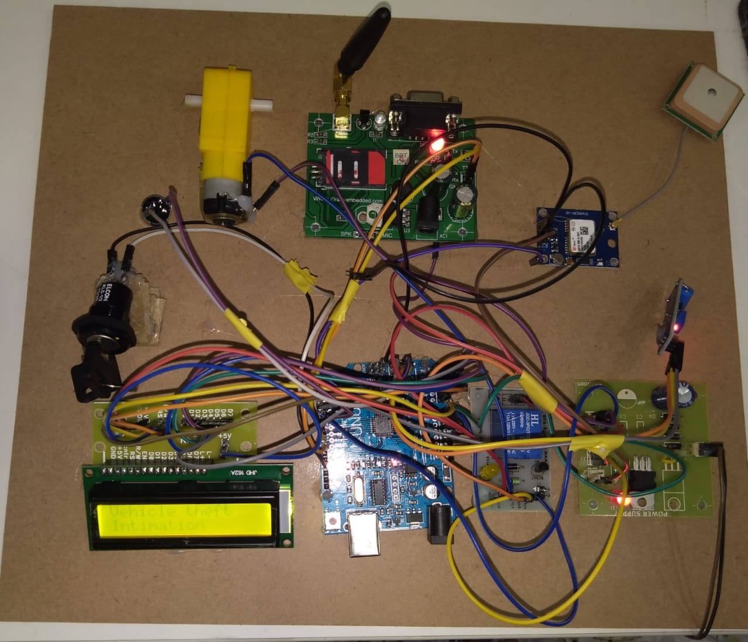
Testing Results:

Slide 22
CONCLUSION:
A novel method of designing a low-cost, compact theft control system for a vehicle was designed & demonstrated in this paper.
This work is an ultimate threat for vehicle thieves. Nowadays, the vehicles are least secured when it is stolen by thieves.
By this work which is presented in this paper, it is very easy to track the vehicle at a higher degree of accuracy, since it is based on GSM Technology, which is very developed now. So, it is very much easy to get back the vehicle.

Slide 23
REFERENCE:
M. A. Mazidi, “The 8051 Microcontroller & Embedded Systems”, Pearson Education Asia, India, 2003.
Kenneth J. Ayala, “The 8051 Microcontroller Architecture, programming &applications”, Penram International, India, 1996.
Douglas V Hall, “Microprocessor and Interfacing-Programming & Hardware by”.
http://www. gisdevelopment.net
National motor vehicle theft reduction conference 2000, Conference Papers (Australia)

Slide 24
Any Queries

Slide 25
Thank you……….

